Slide 1
JAVA CONSOLE APPLICATION
Community Library Management System
An Object-Oriented Inventory & Circulation Solution
GUIDED BY
TEAM MEMBERS
Dr. Sreeram
2620090091 - Sai Sathwik
2620030686 - K. Mokshagna

Slide 2
Project Overview & Objectives
Book Tracking
Member Directory
Circulation Control
Manage catalog records and real-time availability status.
Register community members and maintain profiles.
Streamline book issuing and return workflows.
Slide 2 of 10

Slide 3
Object-Oriented Class Architecture
Book Class
Member Class
LibrarySystem
- bookId, title, author
- memberId
- ArrayList
- isAvailable
- name
- ArrayList
Slide 3 of 10

Slide 4
Book Entity & Attributes
The class encapsulates unique identifiers, bibliographic metadata, and real-time circulation state.
Book
Core Method
bookId: Unique integer identifier
displayBookInfo()
title & author: Book description strings
Formats and prints book records with conditional status indicators ("Available" vs "Issued").
isAvailable: Boolean availability flag
Slide 4 of 10

Slide 5
Member Entity & Registration
The class holds community user credentials, enabling structured lookup and tracking across library operations.
Member
Attributes & Methods
memberId: Unique borrower ID
name: Registered member full name
displayMemberInfo(): Renders profile details
Stored dynamically in memory using robust Java ArrayList structures.
Slide 5 of 10

Slide 6
Inventory & Member Management
Add Book Routine
Register Member
Inventory Viewing
Prompts user for Book ID, Title, and Author, instantly instantiating and appending to bookList.
Collects Member ID and Name, registering new participants into the active memberList.
Iterates through records to display comprehensive status lists with safety checks for empty states.
Slide 6 of 10

Slide 7
Circulation Workflow Logic
Issue Book Process
Return Book Process
1. Search book by ID
1. Search book by ID
2. Validate existence & availability
2. Confirm active issued state
3. Update isAvailable = false
3. Update isAvailable = true
Slide 7 of 10

Slide 8
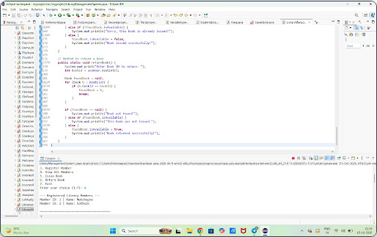
Console Execution Output
Slide 8 of 11

Slide 9
Advantages & Future Scope
Key Benefits
Future Enhancements
Lightweight & Fast Console UI
Database Integration (MySQL)
Clean Object-Oriented Design
JavaFX / Swing GUI Interface
Robust Input Error Handling
Due Dates & Fine Calculations
Slide 9 of 11

Slide 10


Project Source Code & Repository
Access the complete Java source code, documentation, and version history on GitHub:
https://github.com/kallurumokshagnareddy-spec/community-library-management-system
Slide 10 of 11

Slide 11
Thank You!
Questions & Discussion
GUIDED BY
TEAM MEMBERS
Dr. Sreeram
2620090091 - Sai Sathwik | 2620030686 - K. Mokshagna

